Slide 1
Deep Learning Summer School
Introduction to PyTorch Part 1
Lucas Dyssel

Slide 2
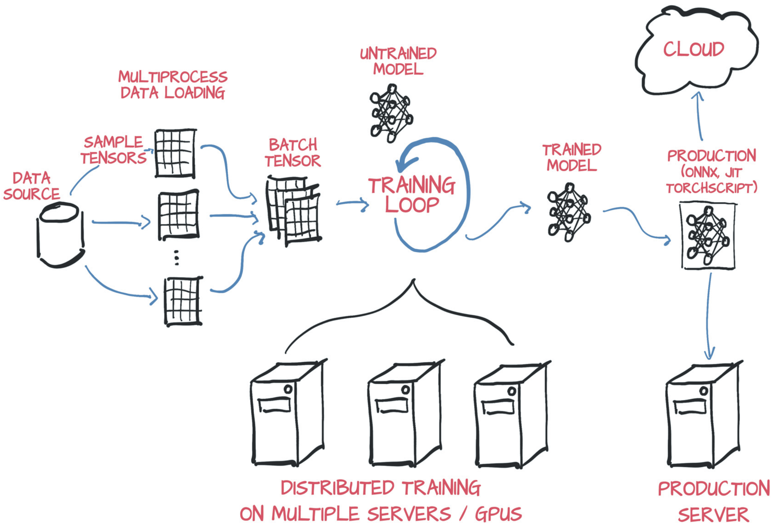
What is PyTorch
PyTorch is an open-source deep learning framework.
It is a flexible and efficient tool for building and training neural networks.
PyTorch offers seamless integration with GPUs, allowing for significant speed-ups in model training.
Run on CPU, NVIDIA GPU, (AMD GPU), Google TPUs...
ONNX Support in PyTorch
PyTorch fully supports ONNX (Open Neural Network Exchange).
Export PyTorch models to ONNX format
Import pre-trained models in ONNX format into PyTorch
Enables conversion of PyTorch models to ONNX format for use in other frameworks, such as TensorFlow.
PyTorch Deep Learning Framework: Speed + Usability | Synced. (2019, December 16).
Synced | AI Technology & Industry Review.
https://syncedreview.com/2019/12/16/pytorch-deep-learning-framework-speed-usability/

Slide 3



Who makes PyTorch?
Developed by Facebook's AI Research (FAIR) Lab
Open-Source Community Collaboration
2022 Pytorch moved to Linux Foundation under the name PyTorch Foundation
Examples of software built on top of PyTorch:
Tesla’s Autopilot
Uber’s Pyro
…

Slide 4
The PyTorch user experience
Intuitive and Pythonic API
PyTorch offers an intuitive and easy-to-use Pythonic API, making it user-friendly for researchers, developers, and data scientists.
Dynamic Computation Graph
PyTorch's dynamic computation graph allows for immediate feedback and easy debugging, providing a more intuitive and flexible user experience compared to static graph frameworks.
Flexible and explicit

Slide 5
How to use PyTorch
An introduction
Lucas Dyssel

Slide 6
Two API Styles
Imperative API (Dynamic Computation Graph):
The Imperative API is the default and most commonly used API in PyTorch.
It allows you to define and execute operations on tensors dynamically as the code is being executed.
With this dynamic computation graph, you can use standard Python control structures (e.g., loops and conditionals) to create complex models without explicitly defining the entire computational graph beforehand.
The Imperative API is well-suited for research, prototyping, and experimentation due to its ease of use and flexibility.
Static API (TorchScript and Tracing):
The Static API in PyTorch, known as TorchScript, allows you to define and compile a model ahead of time.
TorchScript uses a subset of Python syntax and enables you to create a static computational graph, similar to how it's done in static graph frameworks like TensorFlow.
This static nature is useful for deployment scenarios where the model needs to be compiled once and then used for inference with optimized performance.
The Static API provides more control and optimization opportunities for production deployments.

Slide 7
PyTorch Neural Network
nn.Module is the base class for all neural network modules
__init__ initialize the weights, bias, etc.
super(MyNetwork, self).__init__() initialize the parent class (nn.Module)
forward passes the data through the network
forward is a default built-in function. You therefore do not need to write net.forward(x), but can net(x)
import torch import torch.nn as nn class MyNetwork(nn.Module): def __init__(self): super(MyNetwork, self).__init__() self.fc1 = nn.Linear(in_features=10, out_features=20) self.fc2 = nn.Linear(in_features=20, out_features=20) self.fc3 = nn.Linear(in_features=20, out_features=20) self.relu = nn.ReLU() self.softmax = nn.Softmax(dim=1) def forward(self, x): x = self.relu(self.fc1(x)) x = self.relu(self.fc2(x)) x = self.softmax(self.fc3(x)) return x net = MyNetwork()

Slide 8
Options for Layers
Core Layers
Convolutional Layers
Pooling Layers
Padding Layers
Recurrent Layers
Dropout Layers
Normalization Layers
Transformer Layers
Sparse Layers
Vision Layers
Shuffle Layers
Data Parallel Layers

Slide 9
Options for Layers
The core layers perform the most basic operations
They are enough to built FFN Networks
Core Layers
Linear Layers
Activation Layers
Embedding Layers

Slide 10
Linear Layer
Linear layers in neural networks perform a linear transformation on the input data by applying weights and biases to produce output features.
torch.nn.Linear(in_features, # Size of each input sample out_features, # Size of each output sample bias=True, # If set to False, the layer will not learn an additive bias. Default: True device=None, # An optional argument specifying the device (e.g., 'cpu' or 'cuda') where the tensor should be stored dtype=None # An optional argument specifying the data type of the weights and biases tensor )

Slide 11
Activation Function
Activation functions in neural networks introduce non-linearity to the model by applying a specific mathematical function element-wise to the output of a layer, allowing the network to model complex relationships and learn from non-linear patterns in the data.
Pytorch include many activation functions including
softmax
elu
selu
softplus
relu
sigmoid
Tanh
inplace = True means that we modify the input tensor directly without creating a new tensor for the output
relu = torch.nn.ReLU(inplace=False) # Can optionally do the operation in-place. Default: False relu(input)

Slide 12
Loss Functions
Loss functions in neural networks measure the discrepancy between the predicted output and the true target labels, guiding the model during training to minimize the error and improve its performance on the given task.
L1Loss
MSELoss
CrossEntropyLoss
BCELoss
…
input = torch.randn(3, 5, requires_grad=True) # This is only an example, torch.randn generates a random tensor with dimension 3x5 in this case target = torch.randn(3, 5) criterion = torch.nn.MSELoss() loss = criterion(input, target)

Slide 13
Metrics
Metrics are evaluation criteria used to assess the performance of the model after training, quantifying how well the model performs on a specific task
Can be any of the loss functions
Some standard metrics like
F1
Precision
Recall
Accuracy

Slide 14
Optimizer
Optimizers are algorithms used to adjust the model's parameters during training, aiming to minimize the loss function and find the optimal set of weights that best fit the data
The most commonly used optimizers are:
SGD
ADAM
optimizer = torch.optim.SGD(model.parameters(), lr=0.001, momentum=0.9)
Different optimizers take different inputs
The most common are learning rate (lr) and momentum
Optimizers also take the model parameters (weights and bias) as input

Slide 15
Data Loader
DataLoader(dataset, # The dataset from which to load data (e.g., a TensorDataset or custom dataset). batch_size=1, # The number of samples per batch to load. Default is 1 (i.e., no batching). shuffle=False, # If True, shuffles the data at every epoch before creating batches. sampler=None, # Defines the strategy for sampling data indices, mutually exclusive with shuffle. batch_sampler=None, # A custom batch sampler to specify how batches are created, mutually exclusive with batch_size, shuffle, and sampler. num_workers=0, # The number of subprocesses to use for data loading. Default is 0 (loading data in the main process). collate_fn=None, # A function used to collate (merge) individual samples into batches (e.g., to pad variable- sized data). Default is None (using default collation). pin_memory=False, # If True, copies tensors into pinned memory, which can speed up data transfer to GPUs. drop_last=False, # If True, drops the last incomplete batch if the dataset size is not divisible by the batch size. timeout=0, # The timeout value for the data loading processes, useful when using multiple workers. worker_init_fn=None, # A function that is called on each worker process at the beginning of data loading (e.g., setting random seeds). prefetch_factor=2, # Number of additional batches to prefetch (load in advance) for each worker. persistent_workers=False # If True, workers are kept alive after the loading process to reuse them in the next iteration. This can speed up data loading if data loading is the bottleneck. )

Slide 16
Data Loader
from torch.utils.data import Dataset, DataLoader batch_size = 32 train_dataset = CustomDataset(train_data, train_labels) train_loader = DataLoader(train_dataset, batch_size=batch_size, shuffle=True)
train_dataset needs to be a CustomDataset class. In this case we do not add any transformations.
class CustomDataset(Dataset): def __init__(self, data, labels): self.data = data self.labels = labels def __len__(self): return len(self.data) def __getitem__(self, idx): return self.data[idx], self.labels[idx]

Slide 17
Load and Save models
Saving a model
You give it the parameters of a model using MyModel.state_dict() and a path of where you want to save the model including extension
torch.save(MyModel.state_dict(), PATH)
Loading a model
You first need to initialize the network class
Then you need to load a pretrained network by giving it the path including extension
If you then want to use the model without training, you need to set it to evaluation mode by running model.eval()
MyModel = NNetwork() MyModel.load_state_dict(torch.load(PATH)) MyModel.eval()

Slide 18
Train the Model
When training the model you want train multiple times on the data
Each training run through the data is called 1 epoch
In each epoch you want to go through every peace of data in the dataloader
Remember, data in this case is a batch of data (eq. 64 images of cats and dogs). Labels are the class for each of those 64 images
Remember you need to set model.train() when training for each epoch
This is due to some layers behaving different during training
model = NNetwork() criterion = nn.CrossEntropyLoss() optimizer = optim.SGD(model.parameters(), lr=0.01) for epoch in range(num_epochs): model.train() for data, targets in train_loader: optimizer.zero_grad() outputs = model(data) loss = criterion(outputs, targets) loss.backward() optimizer.step()

Slide 19
Train the Model
optimizer.zero_grad() resets the gradients of all the model parameters
model(data) passes a batch of data through the network and comes with predictions on each data piece
criterion calculates using the defined loss function the loss between the outputs and the ground truth
loss.backward() performs backpropagation to calculate the gradients with respect to the model’s parameters
optimizer.step() updates the parameters with respect to the gradients
model = NNetwork() criterion = nn.CrossEntropyLoss() optimizer = optim.SGD(model.parameters(), lr=0.01) for epoch in range(num_epochs): model.train() for data, targets in train_loader: optimizer.zero_grad() outputs = model(data) loss = criterion(outputs, targets) loss.backward() optimizer.step()

Slide 20
Evaluating the Model
When evaluating the performance of your model you need to set model.eval()
This changes the mode of the model to evaluation mode
with torch.no_grad() disables gradient calculation, preventing PyTorch from tracking operations and using memory for backpropagation.
We only need the gradients when training, when evaluating we are not going to update any parameters
torch.max() computes the maximum value and the corresponding index (class label) along an axis
outputs.detach() detaches the tensor from the computation graph, making it independent of any future operations and gradient calculations
model.eval() correct = 0 total = 0 with torch.no_grad(): for data, targets in test_loader: outputs = model(data) _, predicted = torch.max(outputs.detach(), dim=1) total += targets.size(0) correct += (predicted == targets).sum().item() accuracy = 100 * correct / total

Slide 21
Evaluating the Model
total += targets.size(0) increments by the number of samples
correct += (predicted == targets).sum().item() does the same except only for the cases where the network predicted correctly
item() converts the results to a Python integer rather than a tensor
model.eval() correct = 0 total = 0 with torch.no_grad(): for data, targets in test_loader: outputs = model(data) _, predicted = torch.max(outputs.detach(), dim=1) total += targets.size(0) correct += (predicted == targets).sum().item() accuracy = 100 * correct / total

Slide 22
Plotting the training and validation loss
plt.plot creates a line plot where data points are connected by a straight line.
It takes x-coordinates, y-coordinates, and different appearance arguments such as label, color, marker style, linestyle, etc.
In this case ‘bo’ is for blue dot, ‘b’ is for solid blue line
In this case we are plotting both the training loss and the validation loss, we give it a title, x-label, y-label, and legends
plt.show() shows the images
If you want to save the image you can use plt.savefig() which takes a path (‘/path/to/directory/plot.png’)
import matplotlib.pyplot as plt plt.plot(epochs, loss_values, 'bo', label='Training loss') plt.plot(epochs, val_loss_values, 'b', label='Validation loss') plt.title('Training and validation loss') plt.xlabel('Epochs') plt.ylabel('Loss') plt.legend() plt.show()

Slide 23
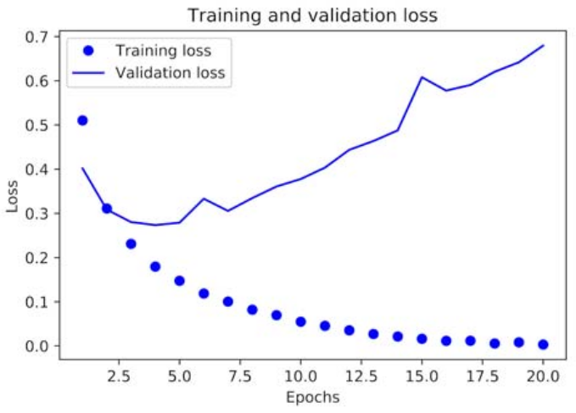
Plotting the training and validation loss

Slide 24
Practical Recommendations
For lower data amounts, you should train smaller and shallower networks in order to prevent overfitting
Preprocessing
Take small values - Typically, most values should be in the 0–1 range.
Be homogenous - That is, all features should take values in roughly the same range.

